Slide 2

PE and sport premium monitoring and tracking form
It is intended that this template should be used as preparation for the completion of the statutory DfE PE and sport premium digital expenditure reporting return. You can upload data (including swimming) from this template onto this platform once it becomes accessible.
The template is a working document that you can amend and update during the year.
Before you decide how you are going to use the funding for this academic year you should reflect and evaluate the impact of your use of you PE and sport premium funding in 2024/25.
You should use your evaluation of last year’s funding to help you decide what to do this academic year, how you will do it, and what impact you expect it to have.
All spending of the funding must conform with the terms outlined in the conditions of grant
The summative digital expenditure reporting from June 2026 will continue to include swimming and water safety information. PE and sport premium funding can be used to provide top-up lessons, where necessary, to ensure pupils meet national curriculum swimming requirements
To ensure funding is used effectively and based on your school’s needs; guidance and examples of best practice across schools can be found here.
You must use the funding to make additional and sustainable improvements to the PE and sport in your school.
You must develop and add to the PESSPA activities that your school already offers.
Useful Links:
PE and sport premium for primary schools - GOV.UK
PE and sport premium: conditions of grant 2025 to 2026 - GOV.UK

Slide 3
Review of the last academic year (2024/2025)
Take some time to reflect on your intent, implementation and impact from last academic year to celebrate your wins but to also think about improvements for the year ahead.
You do not need to complete every box. Just record the information that is key to your school's priorities and areas of focus.
Remember - Be clear about how you focused spending on key groups such as SEND, girls and disadvantaged pupils.
Swimming and Water Safety | What went well? Supporting evidence? | What didn't go well? Supporting evidence?
1. Swim competently, confidently and proficiently over a distance of at least 25 metres | 83% of Y6 cohort were able to swim competently, confidently and proficiently over a distance of at least 25 metres | This breaks down as follows: 14/ 15 boys 10/ 14 girls 4/ 8 SEND 7/ 10 PPG
2. Use a range of strokes effectively (for example, front crawl, backstroke and breaststroke) | 83% of Y6 cohort were able to use a range of strokes effectively (for example, front crawl, backstroke and breaststroke)
3. Perform safe self-rescue in different water-based situations | 83% of Y6 cohort were able to perform safe self-rescue in different water-based situations

Slide 4
Review of the last academic year (2024/2025)
Key areas as outlined in PE and sport premium guidance | What went well? Supporting evidence? | What didn't go well? Supporting evidence?
1. Increasing confidence, knowledge and skills of all staff in teaching PE and sporting activities prioritising CPD and training where needed | The introduction and embedding of the new Complete PE scheme has significantly strengthened the consistency and quality of PE teaching across the school. Staff confidence has increased, particularly in the delivery of gymnastics, dance, and evasion games. Evidence from lesson observations and pupil outcomes shows improved progression and more coherent coverage across year groups.
2. Increasing engagement of all pupils in regular physical activity and sporting activities | Through observations, behaviour logs, and discussions with sports leaders and the school council, we identified opportunities to improve pupils’ breaktime experiences. This highlighted clear next steps for enhancing physical activity during unstructured times. Following our research we purchased the OPAL programme. Audits and observations were carried out ahead of implementation 2025/26.

Slide 5



Review of the last academic year (2024/2025)
Key areas as outlined in PE and sport premium guidance | What went well? Supporting evidence? | What didn't go well? Supporting evidence?
3. Raising the profile of PE and sport across the school, to support whole school improvement | Achieved Bronze ATSA award. The expertise of the P.E. coach is used across all year groups.
4. Offer a broader and more equal experience of a range of sports and physical activities to all pupils and ensure equal access to sport for boys and girls | Whilst the number of pupils attending clubs in the year 2024/25 fell, the number of pupil premium pupils accessing the clubs increased slightly. A broader range of clubs were provided, and included athletics, basketball, football (girls and boys) | The number of pupils accessing after-school clubs fell.
5. Increasing participation in competitive sport

Slide 6
Aims for the next academic year (2025/2026)
Using your whole school priorities, school development plan and previous PE, school sport and physical activity data, set out your aims for the year ahead.
Think about specific areas of need such as inactive girls, SEND and disadvantaged pupils
Remember to also input your swimming data and reflections in the table located at the bottom of this page.
Consider which of the 5 key areas improvements will be focusing on:
1. Increasing confidence, knowledge and skills of all staff in teaching PE and sporting activities prioritising CPD and training where needed.
2. Increasing engagement of all pupils in regular physical activity and sporting activities
3. Raising the profile of PE and sport across the school, to support whole school improvement
4. Offer a broader and more equal experience of a range of sports and physical activities to all pupils and ensure equal access to sport for boys and girls
5. Increasing participation in competitive sport
Swimming and Water Safety | What went well? Supporting evidence? | What didn't go well? Supporting evidence?
1. Swim competently, confidently and proficiently over a distance of at least 25 metres | 100% pupils can swim competently, confidently and proficiently over a distance of at least 25 metres
2. Use a range of strokes effectively (for example, front crawl, backstroke and breaststroke) | 100% pupils can use a range of strokes effectively (for example, front crawl, backstroke and breaststroke)
3. Perform safe self-rescue in different water-based situations | 100% pupils can perform safe self-rescue in different water-based situations

Slide 7
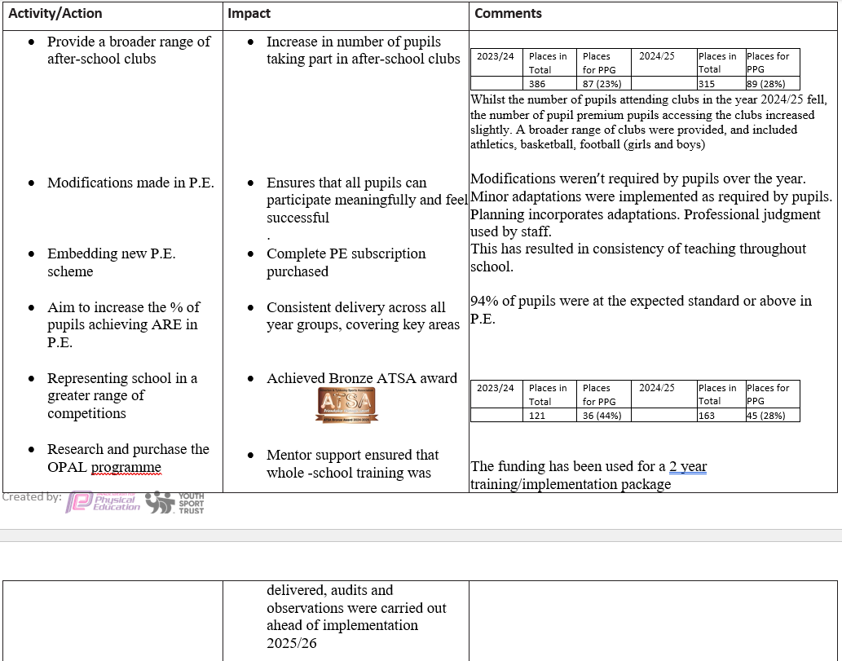
Review of the last academic year (2024/2025)

Slide 8
Plan, monitor and evaluate (2025/2026)
Please aim to use this as a live working document through the year.
Keep returning to this to evidence adaptations and progress made through the PESSPA opportunities you provide.
There is no set number of objectives you must have.
Make as many or as few as you see fit that will support your aims for the year ahead.
Consider which of the 5 key areas improvements will be focusing on:
1. Increasing confidence, knowledge and skills of all staff in teaching PE and sporting activities prioritising CPD and training where needed.
2. Increasing engagement of all pupils in regular physical activity and sporting activities
3. Raising the profile of PE and sport across the school, to support whole school improvement
4. Offer a broader and more equal experience of a range of sports and physical activities to all pupils and ensure equal access to sport for boys and girls
5. Increasing participation in competitive sport

Slide 9
Your objective: Implementation of OPAL
 | Intent - what is your objective? | Implementation - How will you achieve this? | Impact - What do you hope to see? | Supporting evidence
Plan and monitor (Complete now and monitor) | Develop play provision over break and lunchtime to increase activity for all pupils (key indicator 2) | Through OPAL, we aim to create an outdoor environment that enables all children to access a wide range of freely chosen, self‑directed, and meaningful play opportunities. These experiences are designed to enhance children’s physical, emotional, social, and cognitive development, supporting their well‑being and improving their overall enjoyment of school life. | Improved well-being and happiness Greater physical activity and fitness Reduction in behaviour incidents Enhanced social skills and inclusion Increased creativity, problem-solving and resilience More productive teaching time | Behaviour records and reduction in incidents Pupil voice and well-being surveys Increased physical activity levels Enhanced social interaction and inclusion Creativity, problem-solving and risk-taking Parental feedback
 | What impact have you seen? |  | Supporting evidence | Approx. cost
Evaluate (Complete in July) |  |  |  | £1,500

Slide 10
Your objective: Employ a Sports Coach
 | Intent - what is your objective? | Implementation - How will you achieve this? | Impact - What do you hope to see? | Supporting evidence
Plan and monitor (Complete now and monitor) | The objective of employing a sports coach is to raise the quality and breadth of physical education and school sport by providing specialist-led PE teaching, improving staff confidence and subject knowledge, and expanding opportunities for pupils to be active throughout the school day.(key indicator 1) | Delivery of high-quality P.E. sessions Staff professional development Lunchtime physical activity provision After-school sports clubs | Improved quality of P.E. teaching Increased staff competence and confidence Higher levels of physical activity across the school day Increased participation in sport and enrichment Improved behaviour, social skills and well-being Enhanced school culture and provision | Lesson observations show higher quality delivery Staff voice surveys Increased physical activity during breaks Data showing increased participation in after-school clubs
 |  | Are the improvements sustainable? How? | Supporting evidence | Approx. cost
Evaluate (Complete in July) |  |  |  | £10,140

Slide 11
Your objective: Provide sporting opportunities through taster sessions and after-school provisions.
 | Intent - what is your objective? | Implementation - How will you achieve this? | Impact - What do you hope to see? | Supporting evidence
Plan and monitor (Complete now and monitor) | Provide sporting opportunities through taster sessions and lunch time provisions (key indicators 2 & 4) | Identify a range of sporting activities that will appeal to less active children and children from disadvantaged backgrounds, and organise after-school clubs accordingly. | Raise the proportion of children achieving the recommended levels of physical activity, while encouraging less active students both at school and at home to develop an enjoyment of sport. Ensure that children from disadvantaged backgrounds reach recommended activity levels at rates comparable to their peers. | Pupil voice Participation logs Feedback following accessing activities
 | What impact have you seen? | Are the improvements sustainable? How? | Supporting evidence | Approx. cost
Evaluate (Complete in July) | Add text here | Add text here | Add text here | £1,000

Slide 12
Your objective: Successful Implementation of P.E. curriculum throughout school, including nursery
 | Intent - what is your objective? | Implementation - How will you achieve this? | Impact - What do you hope to see? | Supporting evidence
Plan and monitor (Complete now and monitor) | Implementation of a new PE curriculum along with new equipment to support this. (key indicators 1 & 2) | High quality provision of Outdoor PE for all children and increased confidence, competence and pedagogy for all teaching staff. | High quality Outdoor PE curriculum delivered by staff, teaching the fundamental skills through sport. By implementing this, this should ensure a coherent curriculum is used throughout school. Ensure the curriculum is fully supported and resourced to support coherent teaching. | Pupil voice Observation of P.E. sessions Feedback from pupils and staff
 | What impact have you seen? | Are the improvements sustainable? How? | Supporting evidence | Approx. cost
Evaluate (Complete in July) | Add text here | Add text here | Add text here | £3,690

Slide 13
Your objective: Catch up swimming sessions for pupils in Y5
 | Intent - what is your objective? | Implementation - How will you achieve this? | Impact - What do you hope to see? | Supporting evidence
Plan and monitor (Complete now and monitor) | Catch up sessions for children in Years 4 & 5 who have not yet reached the expected standard of swimming after core provision has finished. (key indicator 3) | Arrange for extra lessons in the summer term for those pupils in year 5 who have not met the expected standard in swimming | Raise the proportion of Years 4 & 5 children achieving the required standards at the end of the core provision. | Review outcomes following extra swimming sessions
 | What impact have you seen? | Are the improvements sustainable? How? | Supporting evidence | Approx. cost
Evaluate (Complete in July) | Add text here | Add text here | Add text here | £1,500

