Slide 1

Lesson 1:
Introduction and Impressionism
Computing Scheme of Work
Unit 2.6 – Creating Pictures
Notes:
Resources
Unless otherwise stated, all resources can be found on the main unit 2.6 page. From here, click on the icon to set a resource as a 2Do for your class. Use the links below to preview the resources; right-click on the link and ‘open in new tab’ so you don’t lose this page.
Examples of impressionist art.
Impressionism fact file from Appendix 1; this is a brief fact file for your own use.
There is a 2Publish activity called ‘Art Impressionism’ that children could use to create an impressionism fact file as an extension to this work. This will need to be set as a 2Do before hand.
2Paint a Picture. This is found in the Tools area of Purple Mash.

Slide 2


Aims
Slide 2
To explore 2Paint A Picture.
To look at the work of Impressionist artists and recreate them using the Impressionism template.
Need more support? Contact us:
Tel: +44(0)208 203 1781 | Email: support@2simple.com | Twitter: @2simplesoftware
Notes:
Display slide 2 and outline the lesson aims.

Slide 3
Success Criteria
Slide 3
Children can describe the main features of impressionist art.
Children can use 2Paint A Picture to create their own art based upon this style.
Need more support? Contact us:
Tel: +44(0)208 203 1781 | Email: support@2simple.com | Twitter: @2simplesoftware
Notes:
Display slide 3 and outline the success criteria.

Slide 4
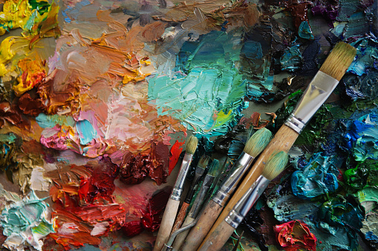

Slide 4
Impressionist Art
Let’s look at some examples of Impressionist art.
What do you notice about the pictures?
How might you describe the style?
What do you think the pictures have in common?
Need more support? Contact us:
Tel: +44(0)208 203 1781 | Email: support@2simple.com | Twitter: @2simplesoftware
Notes:
Show the children some pictures of impressionist art and think about the questions on slide 4. You might like to have a look at: https://www.tate.org.uk/kids/explore/what-is/impressionism. Use the information in Appendix 1 (or your own information) to talk about Impressionism.

Slide 5

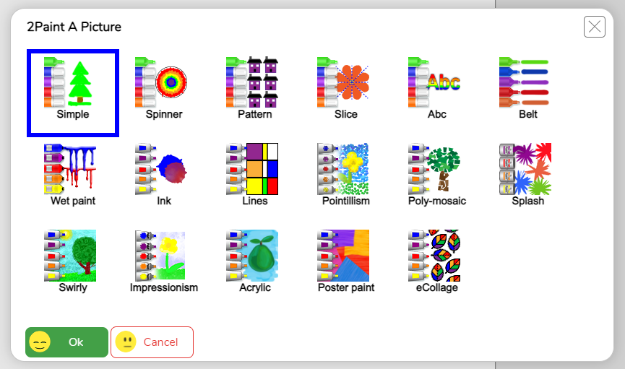

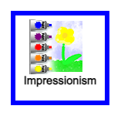
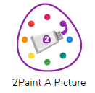
2Paint A Picture
Slide 5
Today we are using the Purple Mash tool, 2Paint A Picture.
This is a drawing tool that helps you to create various painting effects and combine these effects to make pictures.
When the tool is first opened, you will see a choice of painting effects. We will be looking at these over the next few lessons. Today, we will look at Impressionism.
Need more support? Contact us:
Tel: +44(0)208 203 1781 | Email: support@2simple.com | Twitter: @2simplesoftware
Notes:
With slide 5, introduce the tool 2paint A Picture and show children how to access it on Purple Mash. Explain that today we will be using the Impressionism template.

Slide 6
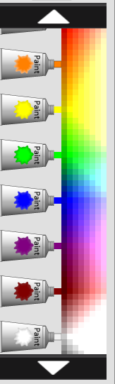





2Paint A Picture - Impressionism
Slide 6
The tubes of paint have been ‘squeezed out’ and mixed in the palette on the left so they are ready for the impressionist artist to capture the impression.
You can select a colour and then mix it with more water to give it a watered down effect.
Less water
More water
You can scroll through the palette to see other colours by pressing on the white arrows.
You can also change the thickness of the brush strokes using this scale.
Need more support? Contact us:
Tel: +44(0)208 203 1781 | Email: support@2simple.com | Twitter: @2simplesoftware
Notes:
With slide 6, demonstrate the features of the Impressionist template on 2Paint A Picture. Allow children time to open the tool on their own devices and explore.

Slide 7
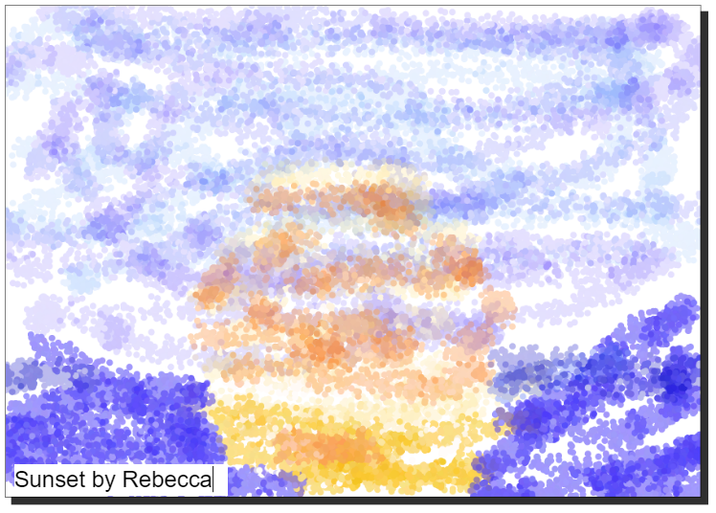
Activity 1: Create an Impressionist-style Painting.
Slide 7
Have a go at creating your own impressionist-style painting.
Give your painting a title and ‘sign’ your art when you are finished.
Remember to save your work in your My Work folder with an appropriate name when you have finished.
Need more support? Contact us:
Tel: +44(0)208 203 1781 | Email: support@2simple.com | Twitter: @2simplesoftware
Notes:
Use slide 7 to introduce the main activity of the lesson where the children will create their own impressionist-style piece of art. Remind children to save their work. If you have a class blog or display board, they could then share their work by clicking on the share button. (For further details about sharing work, see the Sharing Work Guide.)

Slide 8
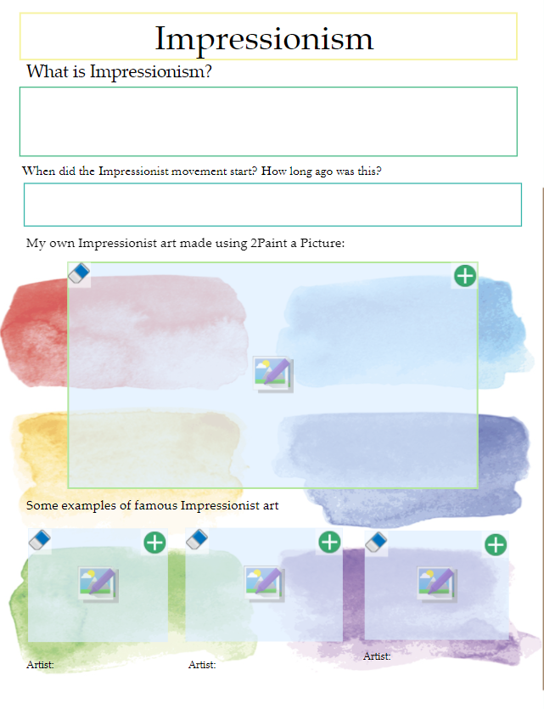
Activity 2: Extension
Slide 8
Complete the writing frame about Impressionism including adding your own work from 2 Paint A Picture.
To do this, you will have to save a copy of your picture to your device first, so you can upload it into this writing frame.
Need more support? Contact us:
Tel: +44(0)208 203 1781 | Email: support@2simple.com | Twitter: @2simplesoftware
Notes:
Use slide 8 to introduce an optional extension task activity: Art Impressionism. (You will need to set this as a 2Do in advance).

Slide 9
Review Success Criteria
Slide 9
I can describe the main features of impressionist art.
I can use 2Paint A Picture to create my own art based upon this style.
Need more support? Contact us:
Tel: +44(0)208 203 1781 | Email: support@2simple.com | Twitter: @2simplesoftware
Notes:
Review the success criteria on slide 9.

