Slide 2
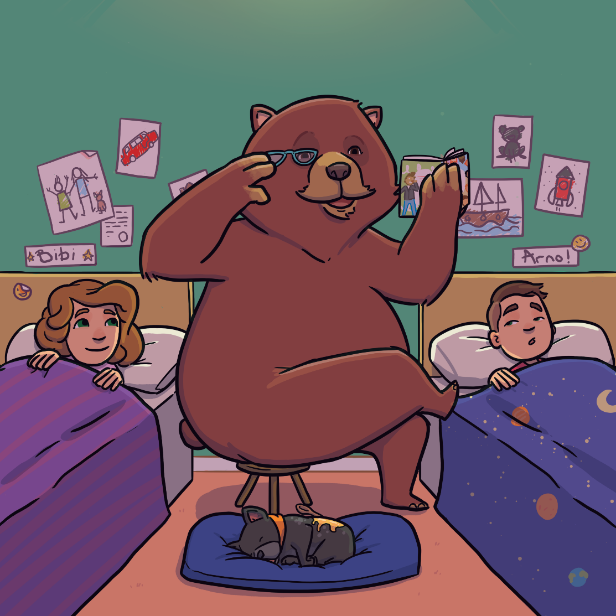
The Bear Babysitter
The bear has a rather unusual job, for a bear.
The bear is a babysitter.

Slide 3
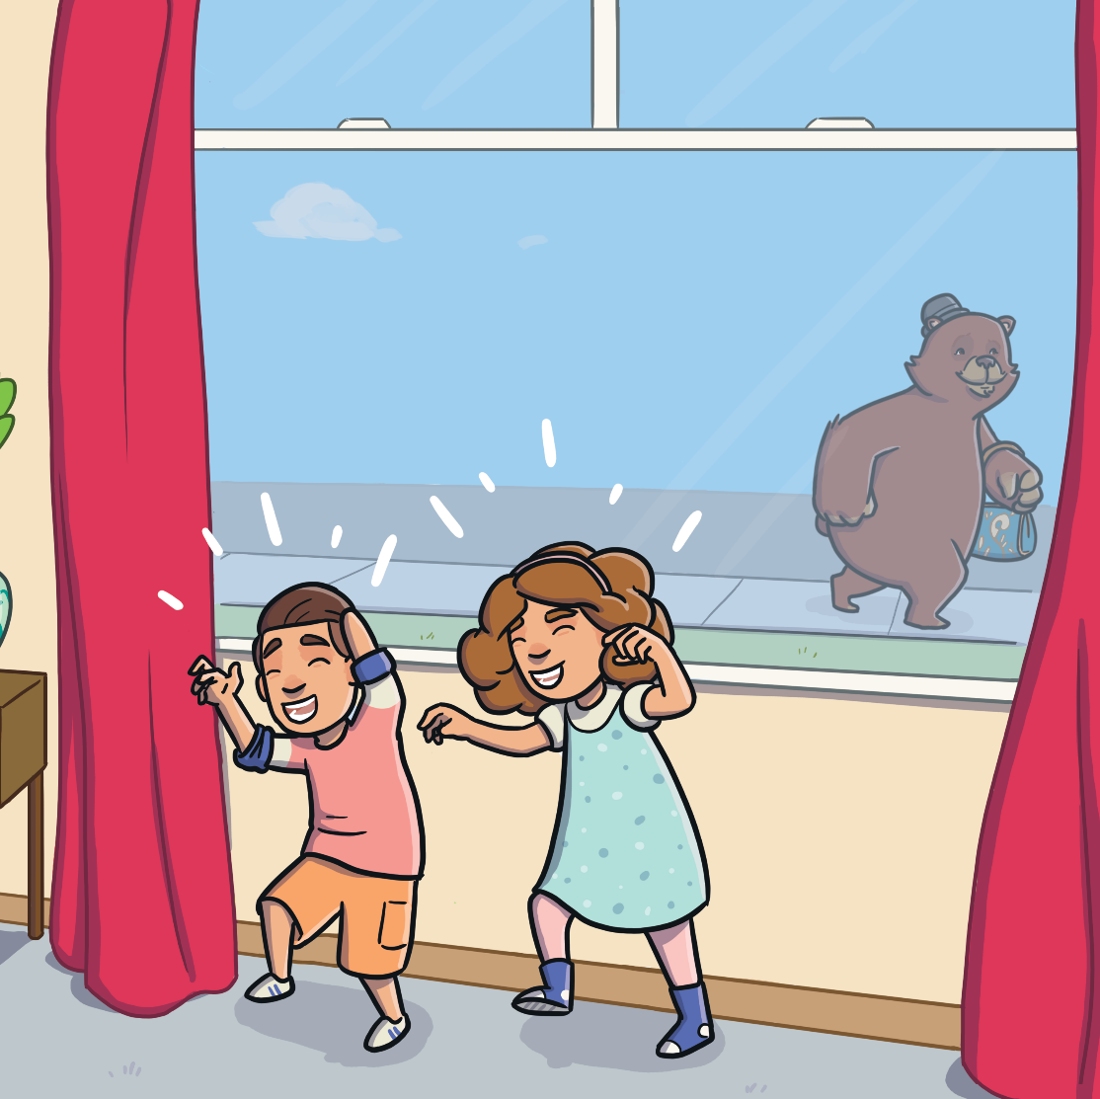
The Bear Babysitter
The bear finishes babysitting Arno and Bibi.
Where will the bear find
someone else to babysit?

Slide 4
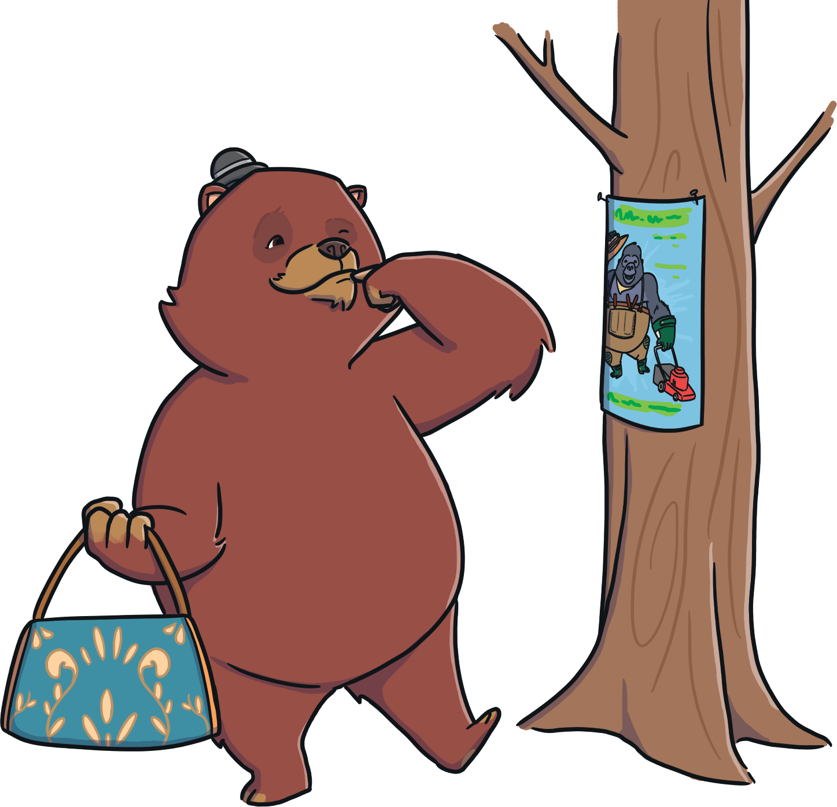
The Bear Babysitter
On the way home, the bear spots something interesting.
It’s a poster. It is advertising the services of a gorilla gardener.

Slide 5
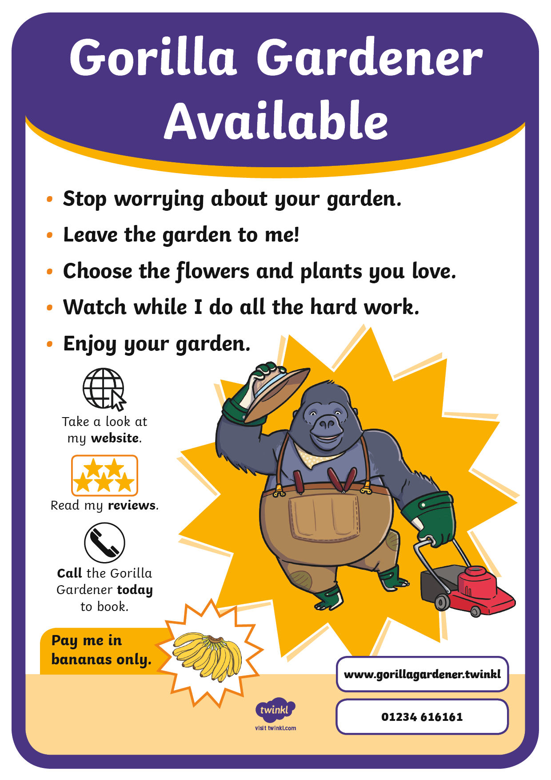
The Gorilla Gardener
Let’s read the poster together.
What do you notice about the way it is written?
The poster is using command sentences to persuade us to
book the gorilla gardener.

Slide 6
Commands
Commands are sentences that tell you to do something. They are found in instructions and start with an imperative verb (bossy word).
Water the plants every day.
In a persuasive poster, the command might be telling us to do
or buy something.
Try our new pink tulips in your garden today.
Examples of imperative verbs:
push
watch
listen
come
look
go

Slide 7
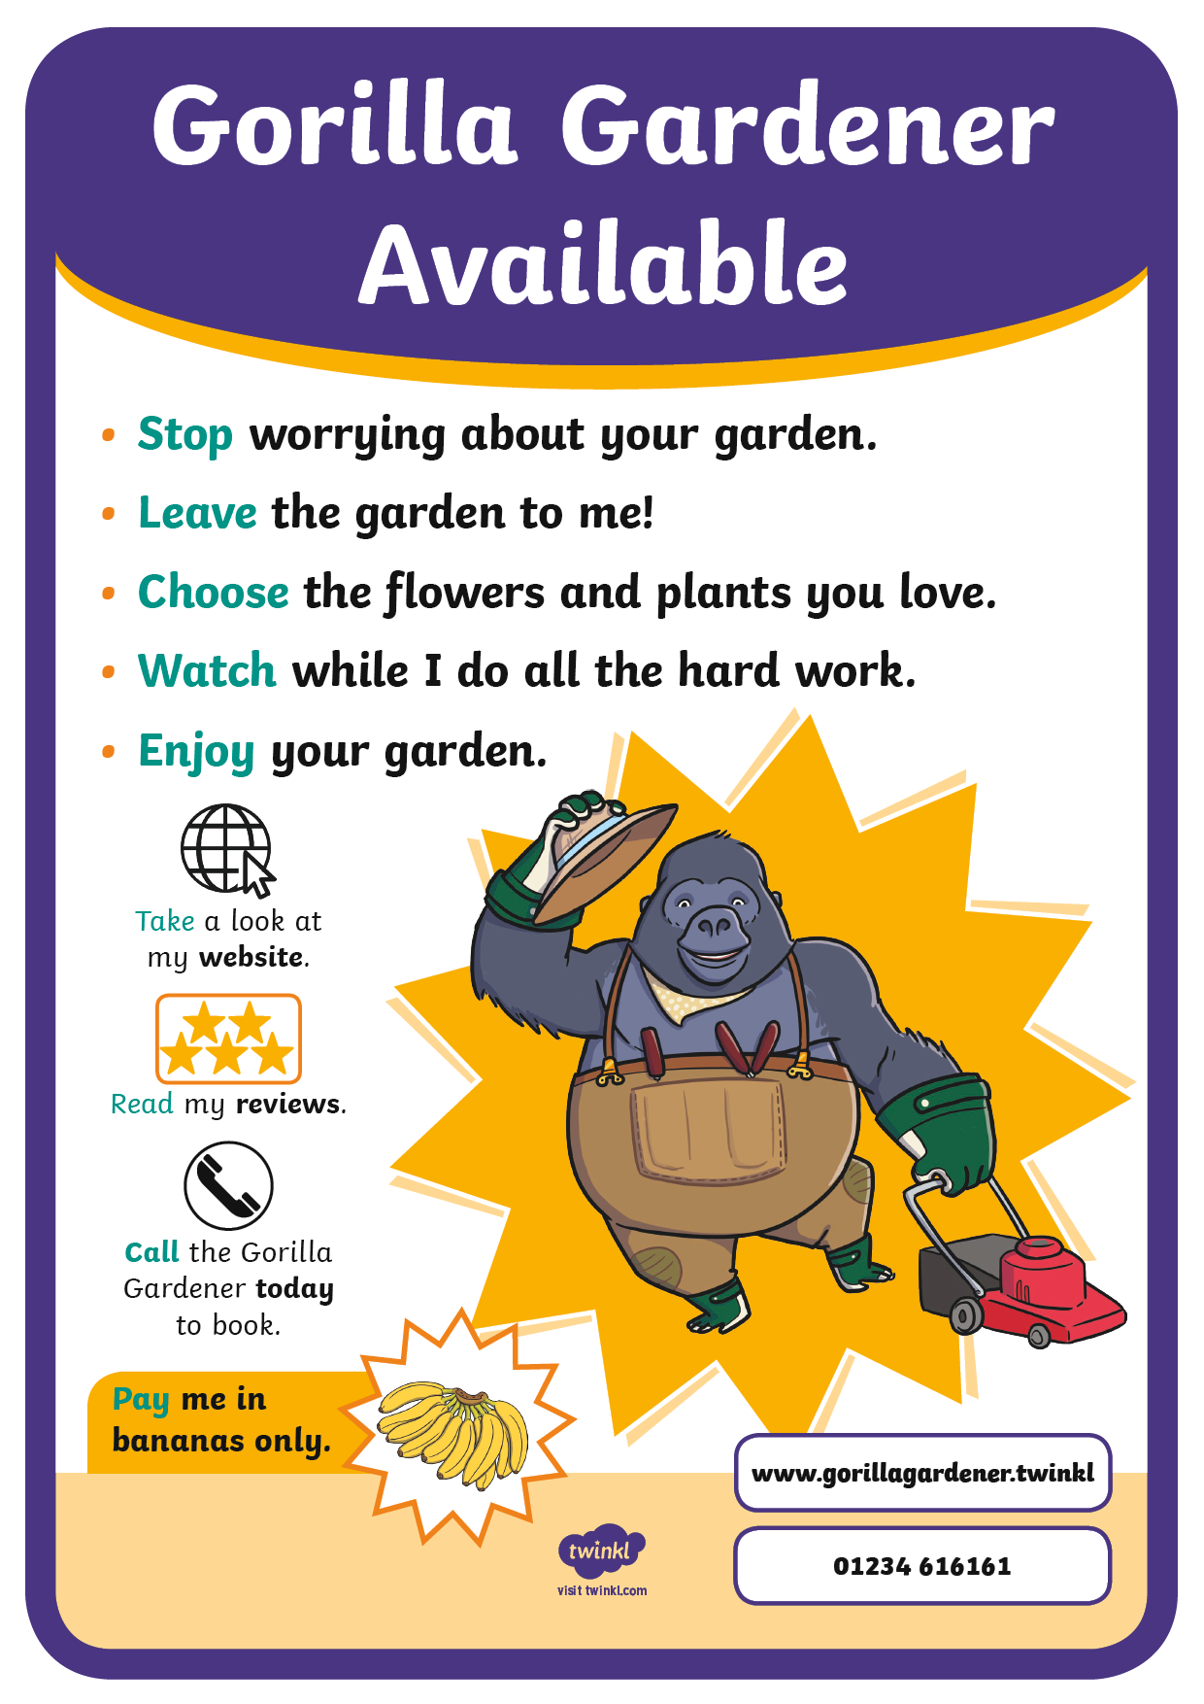
The Gorilla Gardener
Can you spot the command sentences in the poster?
Look out for the imperative verbs (bossy words) at the start of the sentences.

Slide 8

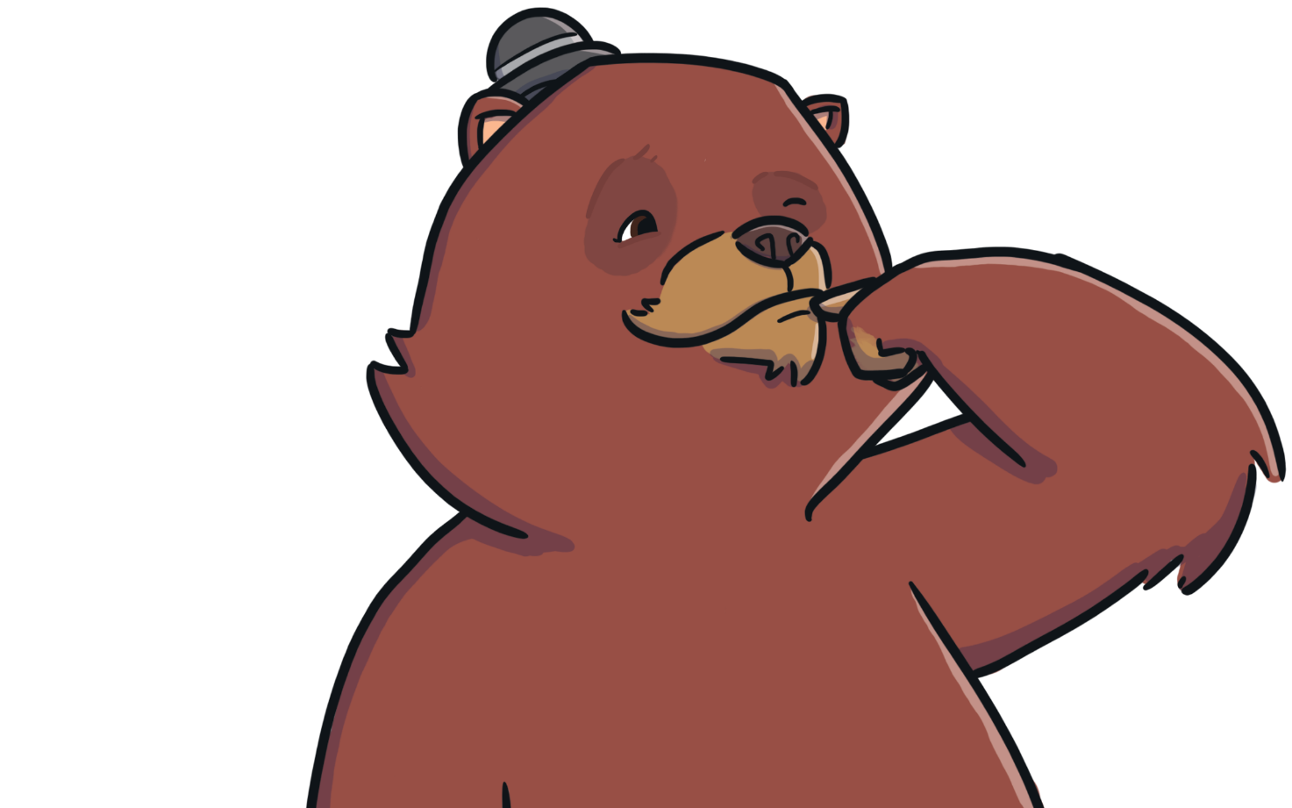
The Bear’s Poster
The Gorilla Gardener’s poster gives the bear an idea.
The bear decides to make
a poster!

Slide 9
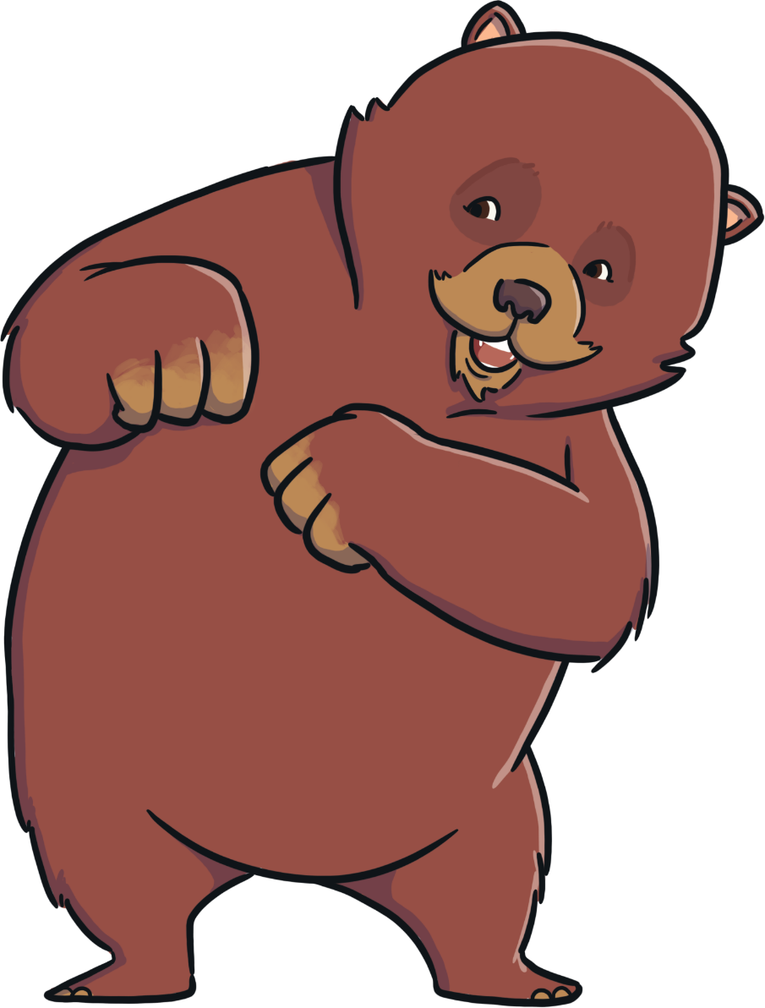
The Bear’s Poster
Can you make a poster to advertise the bear’s babysitting services?
Make sure you use command sentences in your poster.
Start each command sentence with an imperative verb (bossy word).

