Slide 1

Lesson 2:
Pointillist Art
Computing Scheme of Work
Unit 2.6 – Creating Pictures
Notes:
Resources
Unless otherwise stated, all resources can be found on the main unit 2.6 page. From here, click on the icon to set a resource as a 2Do for your class. Use the links below to preview the resources; right-click on the link and ‘open in new tab’ so you don’t lose this page.
Examples of pointillism art.
Pointillism Fact File from appendix 2; this is a brief fact file for your own use.
There is a 2Publish activity called ‘Art Pointillism’ that children could use to create an impressionism fact file as an extension to this work. This will need to be set as a 2Do before hand.
2Paint A Picture; This is found in the Tools area of Purple Mash.

Slide 2


Aims
Slide 2
To look at the work of pointillist artists such as Seurat.
To recreate pointillist art using the Pointillism template.
Need more support? Contact us:
Tel: +44(0)208 203 1781 | Email: support@2simple.com | Twitter: @2simplesoftware
Notes:
Display slide 2 and outline the lesson aims.

Slide 3
Success Criteria
Slide 3
Children can explain what pointillism is.
Children can use 2Paint A Picture to create their own art based upon this style.
Need more support? Contact us:
Tel: +44(0)208 203 1781 | Email: support@2simple.com | Twitter: @2simplesoftware
Notes:
Display slide 3 and outline the success criteria.

Slide 4
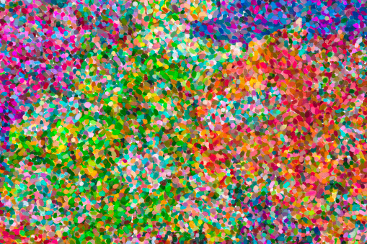

Slide 4
Pointillist Art
Let’s look at some examples of pointillist art.
What do you notice about the pictures?
How might you describe the style?
How is it different from impressionist art?
Need more support? Contact us:
Tel: +44(0)208 203 1781 | Email: support@2simple.com | Twitter: @2simplesoftware
Notes:
Show the children some pictures of pointillist art and think about the questions on slide 4. Use the information in Appendix 2 (or your own information) to talk about pointillism.

Slide 5

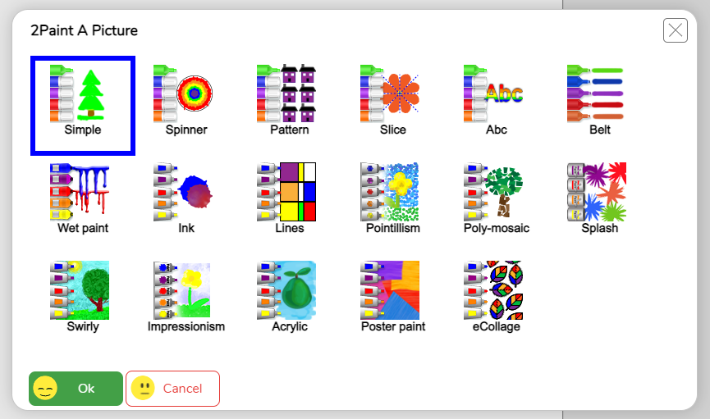
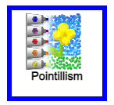

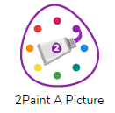
2Paint A Picture
Slide 5
Today we will continue using the Purple Mash tool, 2Paint A Picture.
Which template do you think we will be using today?
Need more support? Contact us:
Tel: +44(0)208 203 1781 | Email: support@2simple.com | Twitter: @2simplesoftware
Notes:
With slide 5, introduce the tool 2Paint A Picture and show children how to access it on Purple Mash. Explain that today we will be using the Pointillism template.

Slide 6
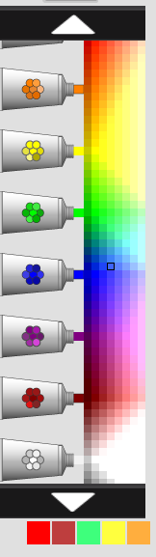





2Paint A Picture - Pointillism
Slide 6
The paint comes out as dots in different shades of a certain colour palette.
You can select a colour and then add water as before to dilute the colour.
Less water
More water
You can scroll through the palette to see other colours by pressing on the white arrows.
You can also change the size of the dots using this scale.
Need more support? Contact us:
Tel: +44(0)208 203 1781 | Email: support@2simple.com | Twitter: @2simplesoftware
Notes:
With slides 6 and 7, demonstrate the features of the Pointillism template on 2Paint A Picture. Allow children time to open the tool on their own devices and explore.

Slide 7


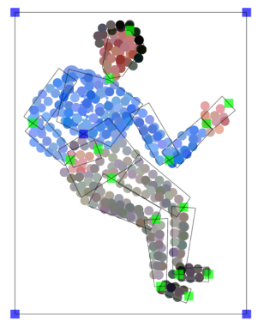
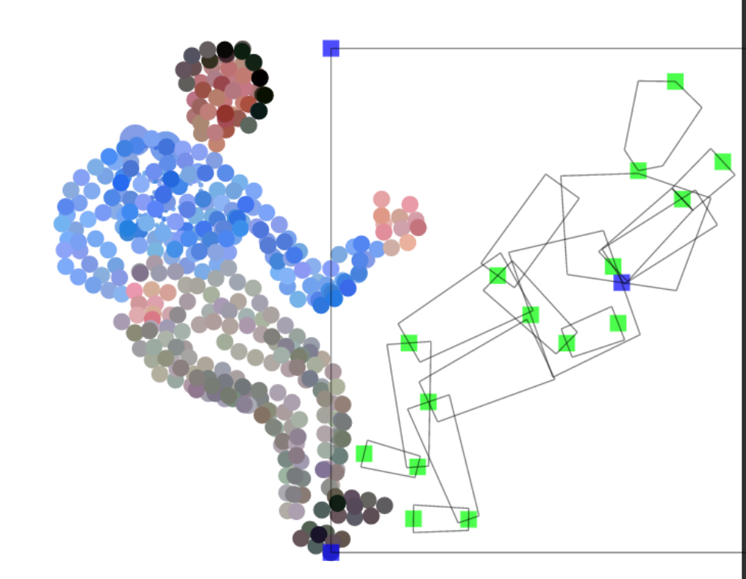

2Paint A Picture - Pointillism
Slide 7
On the top right of the screen, there is a button that gives some outline options that can help with painting.
These outlines can be resized and repositioned using the blue and green draggable squares on them. So, you could position a person template and use it as a guide to paint a person in a particular position.
Once you have filled in the template, you can move and reposition it to add more people.
Remember you can always use the undo button if you make a mistake.
Need more support? Contact us:
Tel: +44(0)208 203 1781 | Email: support@2simple.com | Twitter: @2simplesoftware
Notes:
With slides 6 and 7, demonstrate the features of the Pointillism template on 2Paint A Picture. Allow children time to open the tool on their own devices and explore.

Slide 8
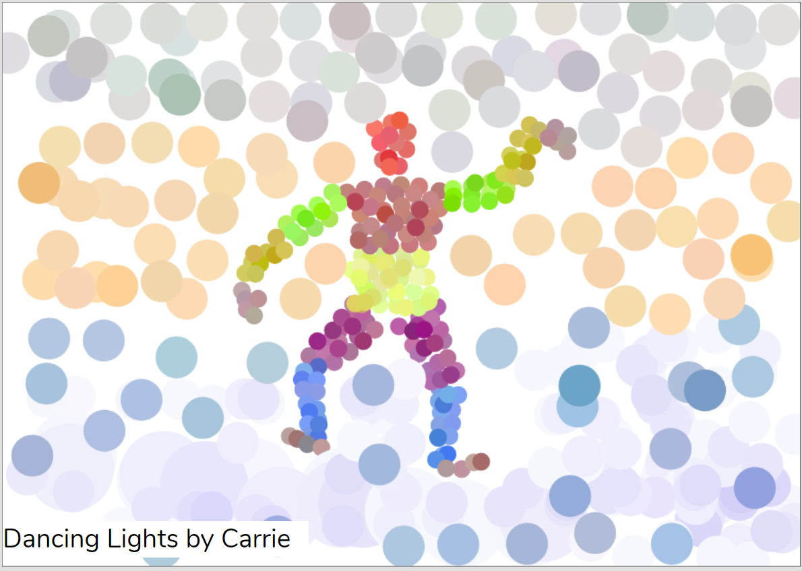
Activity 1: Create a pointillist-style Painting.
Slide 8
Have a go at creating your own pointillist-style painting.
Give your painting a title and ‘sign’ your art when you are finished.
Remember to save your work in your My Work folder with an appropriate name when you have finished.
Need more support? Contact us:
Tel: +44(0)208 203 1781 | Email: support@2simple.com | Twitter: @2simplesoftware
Notes:
Use slide 8 to introduce the main activity of the lesson where the children will create their own pointillist-style piece of art. Remind children to save their work. If you have a class blog or display board, they could then share their work by clicking on the share button. (For further details about sharing work, see the Sharing Work Guide)

Slide 9
Pointillist Art – Using paints or the computer.
Slide 9
The artists who invented this style did not have access to computers so would always have used real paint and paper.
How can you compare painting in this style on the computer and using real paint?
How different do you think this would be?
What would be the advantages and disadvantages of each method?
Need more support? Contact us:
Tel: +44(0)208 203 1781 | Email: support@2simple.com | Twitter: @2simplesoftware
Notes:
Use slide 9 to discuss the differences of creating art in this style on the computer and with real paint. If you have time, the children could try creating pointillist art during an art lesson using paints and compare the two.

Slide 10
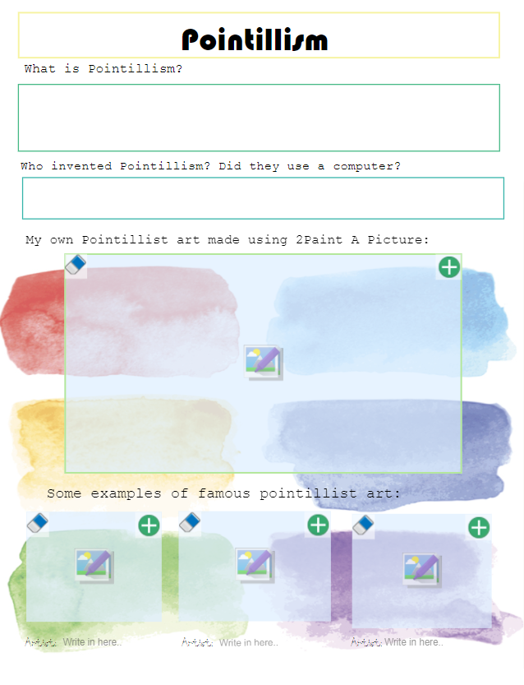
Activity 2: Extension
Slide 10
Complete the writing frame about Pointillism including adding your own work from 2Paint A Picture.
To do this, you will have to save a copy of your picture to your device first, so you can upload it into this writing frame.
Need more support? Contact us:
Tel: +44(0)208 203 1781 | Email: support@2simple.com | Twitter: @2simplesoftware
Notes:
Use slide 10 to introduce an optional extension task activity: Art Pointillism. (You will need to set this as a 2Do in advance).

Slide 11
Review Success Criteria
Slide 11
I can explain what pointillism is.
I can use 2Paint A Picture to create my own art based upon this style.
Need more support? Contact us:
Tel: +44(0)208 203 1781 | Email: support@2simple.com | Twitter: @2simplesoftware
Notes:
Review the success criteria on slide 11.

